Slide 1







DBL
Digital Building LogBook
DBP
Digital Building Permit
EPC
Energy Performance Certificate
LCA
Life Cycle Assessment
BAMB
Buildings as Material Banks
3DC
3D Cadastre
REM
Real Estate Management
PRA
Public Revenue Administration
d4SU services
FastAPI
redis
Celery
Ifc
IfcOpenShell
Ifc2JSON
PostGIS
AGE
PostgreSQL

Slide 2








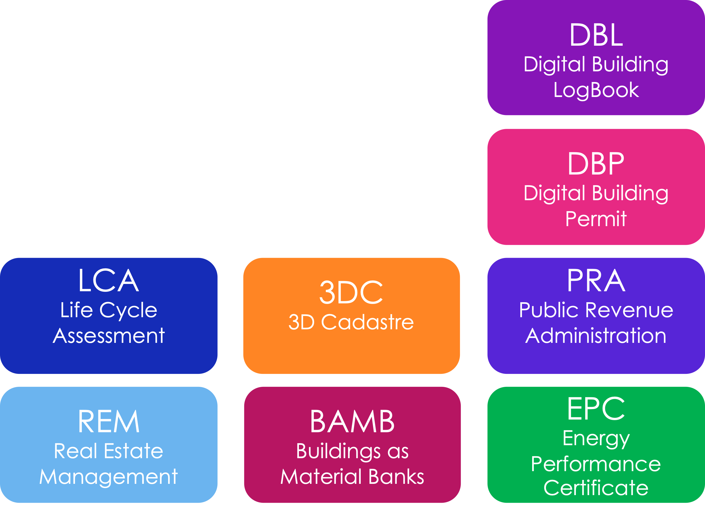
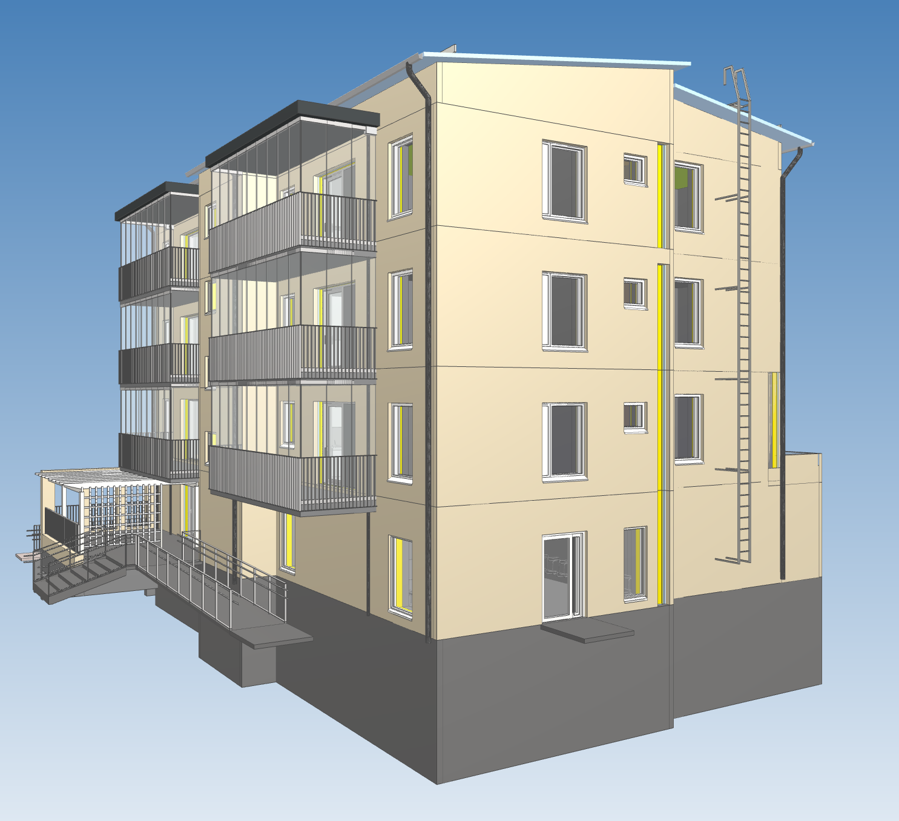
AECO Professional
Citizen / Enterprise
Public Service Agent
Papers & Forms
Constituents Portal &
Digital Public Services
Platform
AECO
Industry
SW Tools
Public
Administration
SW Tools
Integration
Platform
Integration?

Slide 3



AECO Professional
Citizen / Enterprise
Public Service Agent
Data
Dictionary
Constituents Portal &
Digital Public Services
Platform
AECO
Industry
SW Tools
Public
Administration
SW Tools
Integration
Platform
Data for Spatial Units
d4SU
Platform

Slide 4

Requirements
Data
Dictionary
AECO
Industry
Public
Administration
d4SU
Check
IFC|IDS
& Process IFC

Slide 5
DBL
Digital Building LogBook
DBP
Digital Building Permit
LCA
Life Cycle Assessment
3DC
3D Cadastre
PRA
Public Revenue Administration
REM
Real Estate Management
BAMB
Buildings as Material Banks
EPC
Energy Performance Certificate

Slide 6


AECO Tool
Provide Domain Data in IFC format
Complex
cases
d4SU
Leverage
BIM Tooling
Add domain logic in any preferred tool
Custom Tool
Provide Data in Json format
d4SU
Convert to IFC
Simple
cases

Slide 7

Integration Platform
d4SU Server
Celery Worker(s)
Check
Sync & Async
request / response
Broker and Result Store (Redis)
Convert
Geometry
Filter
Store
FastAPI
Export
IfcOpenShell
Extract
Host
Workflow
PostgreSQL
File Store
Apache
Arrow FS

Slide 8
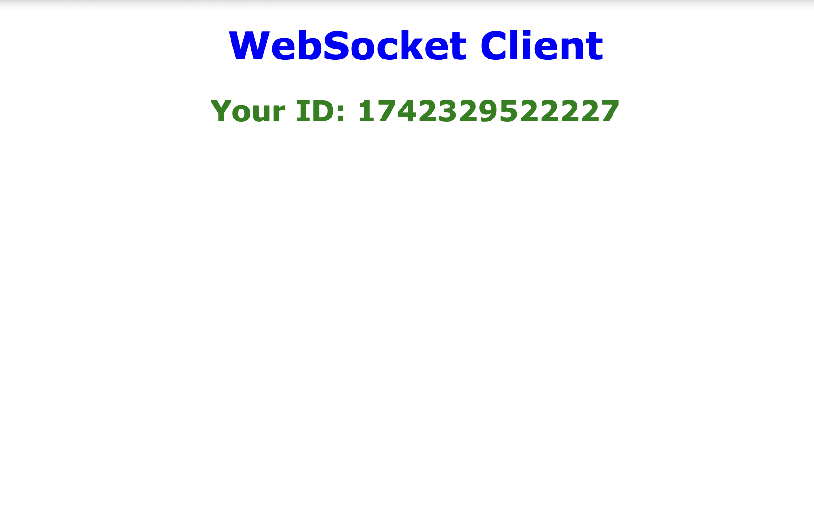
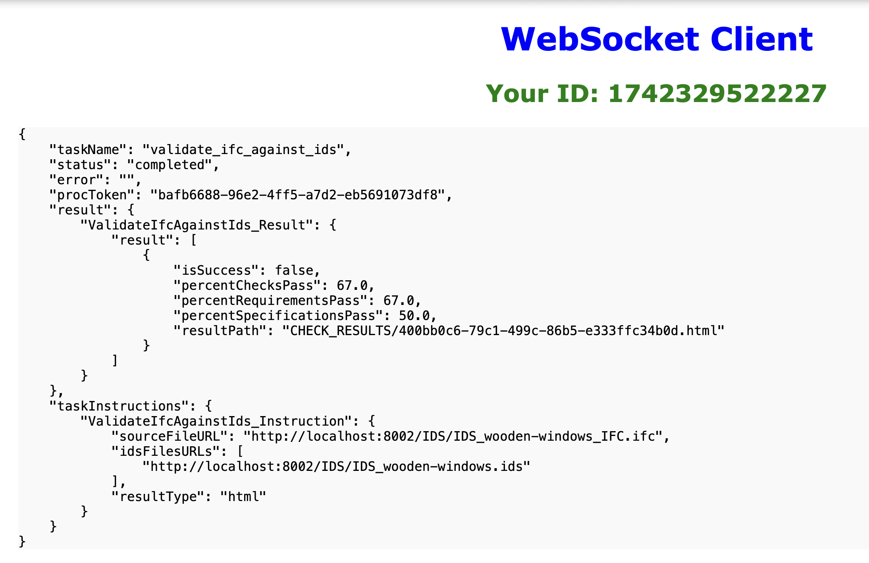
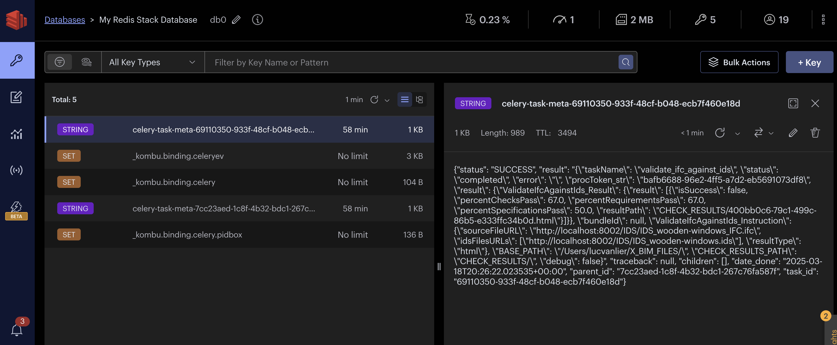
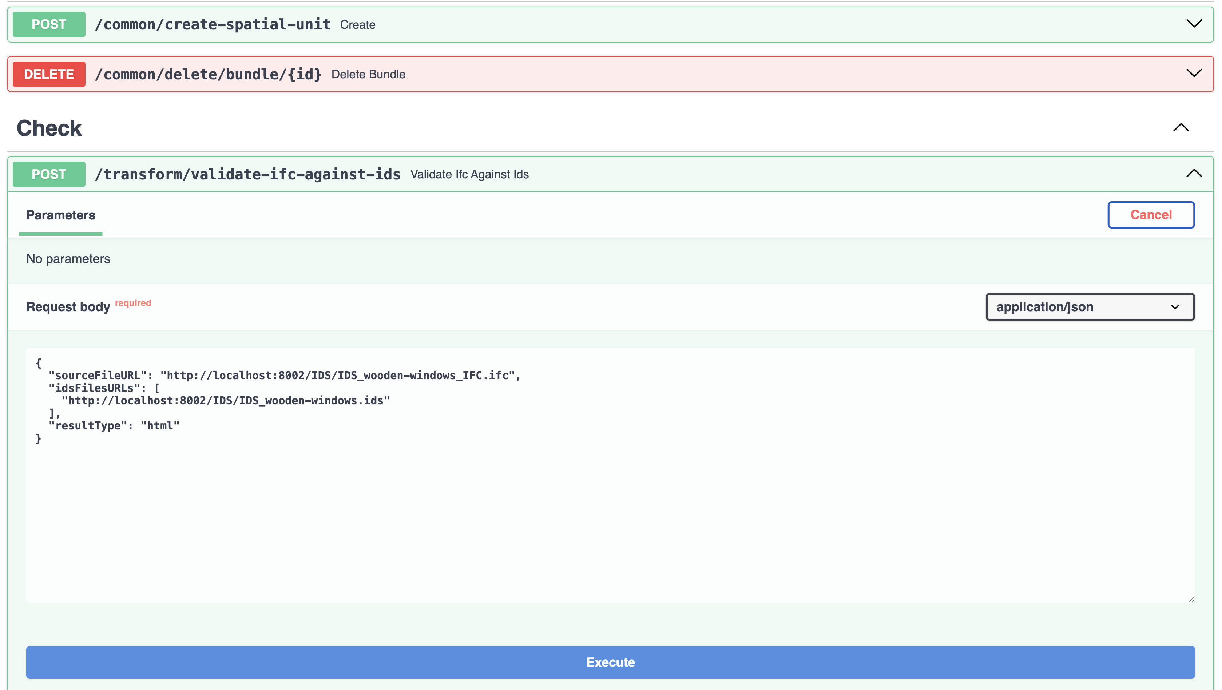
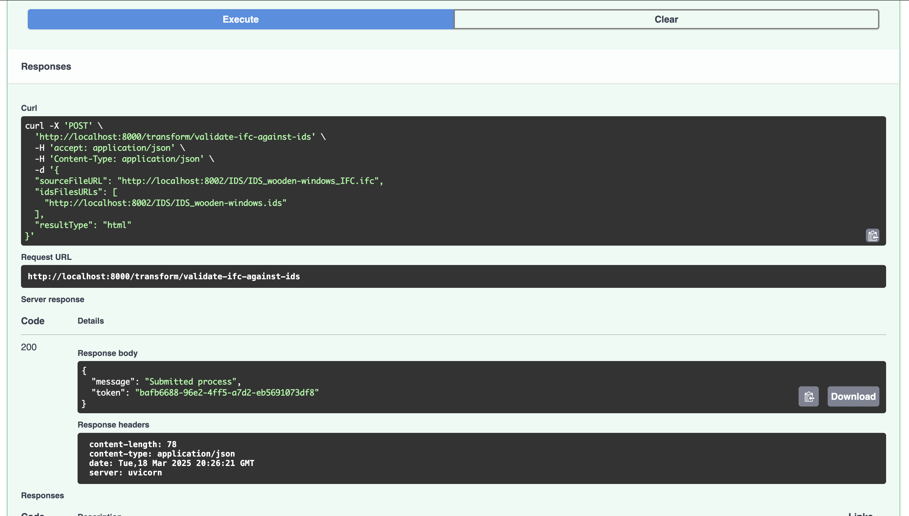
4
3
1
2
req
2
rsp

Slide 9
SVG’s

Slide 10
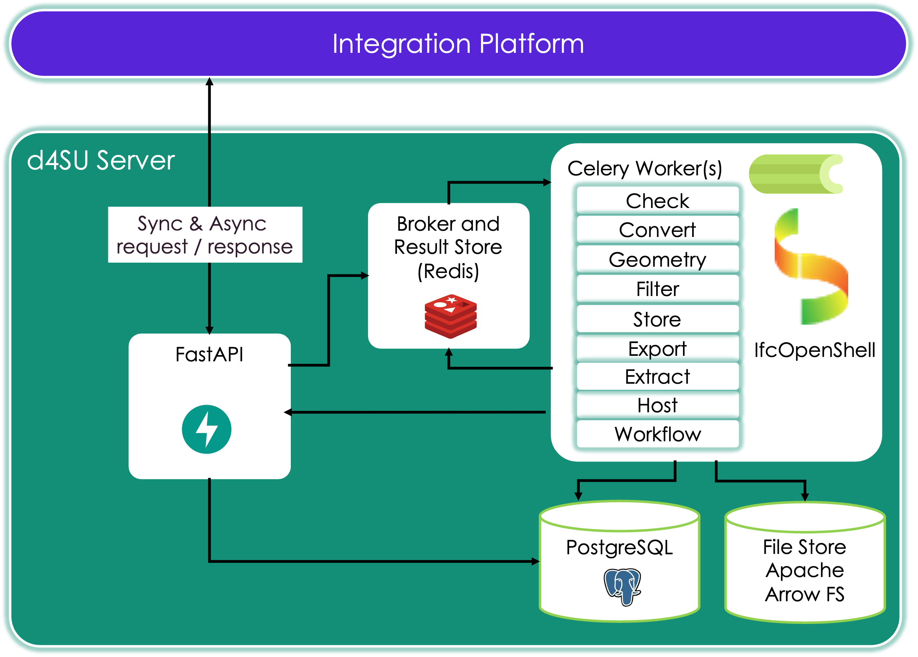

Slide 11
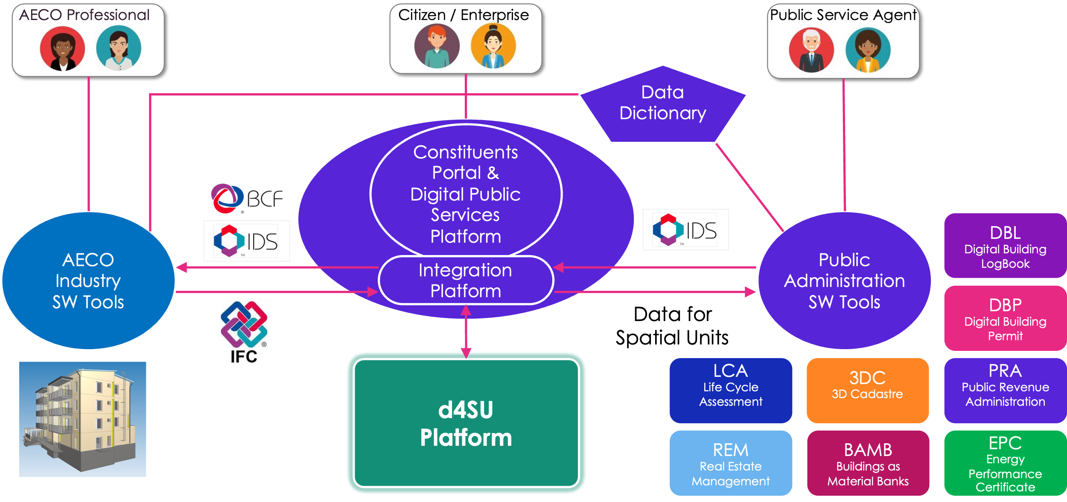

Slide 12
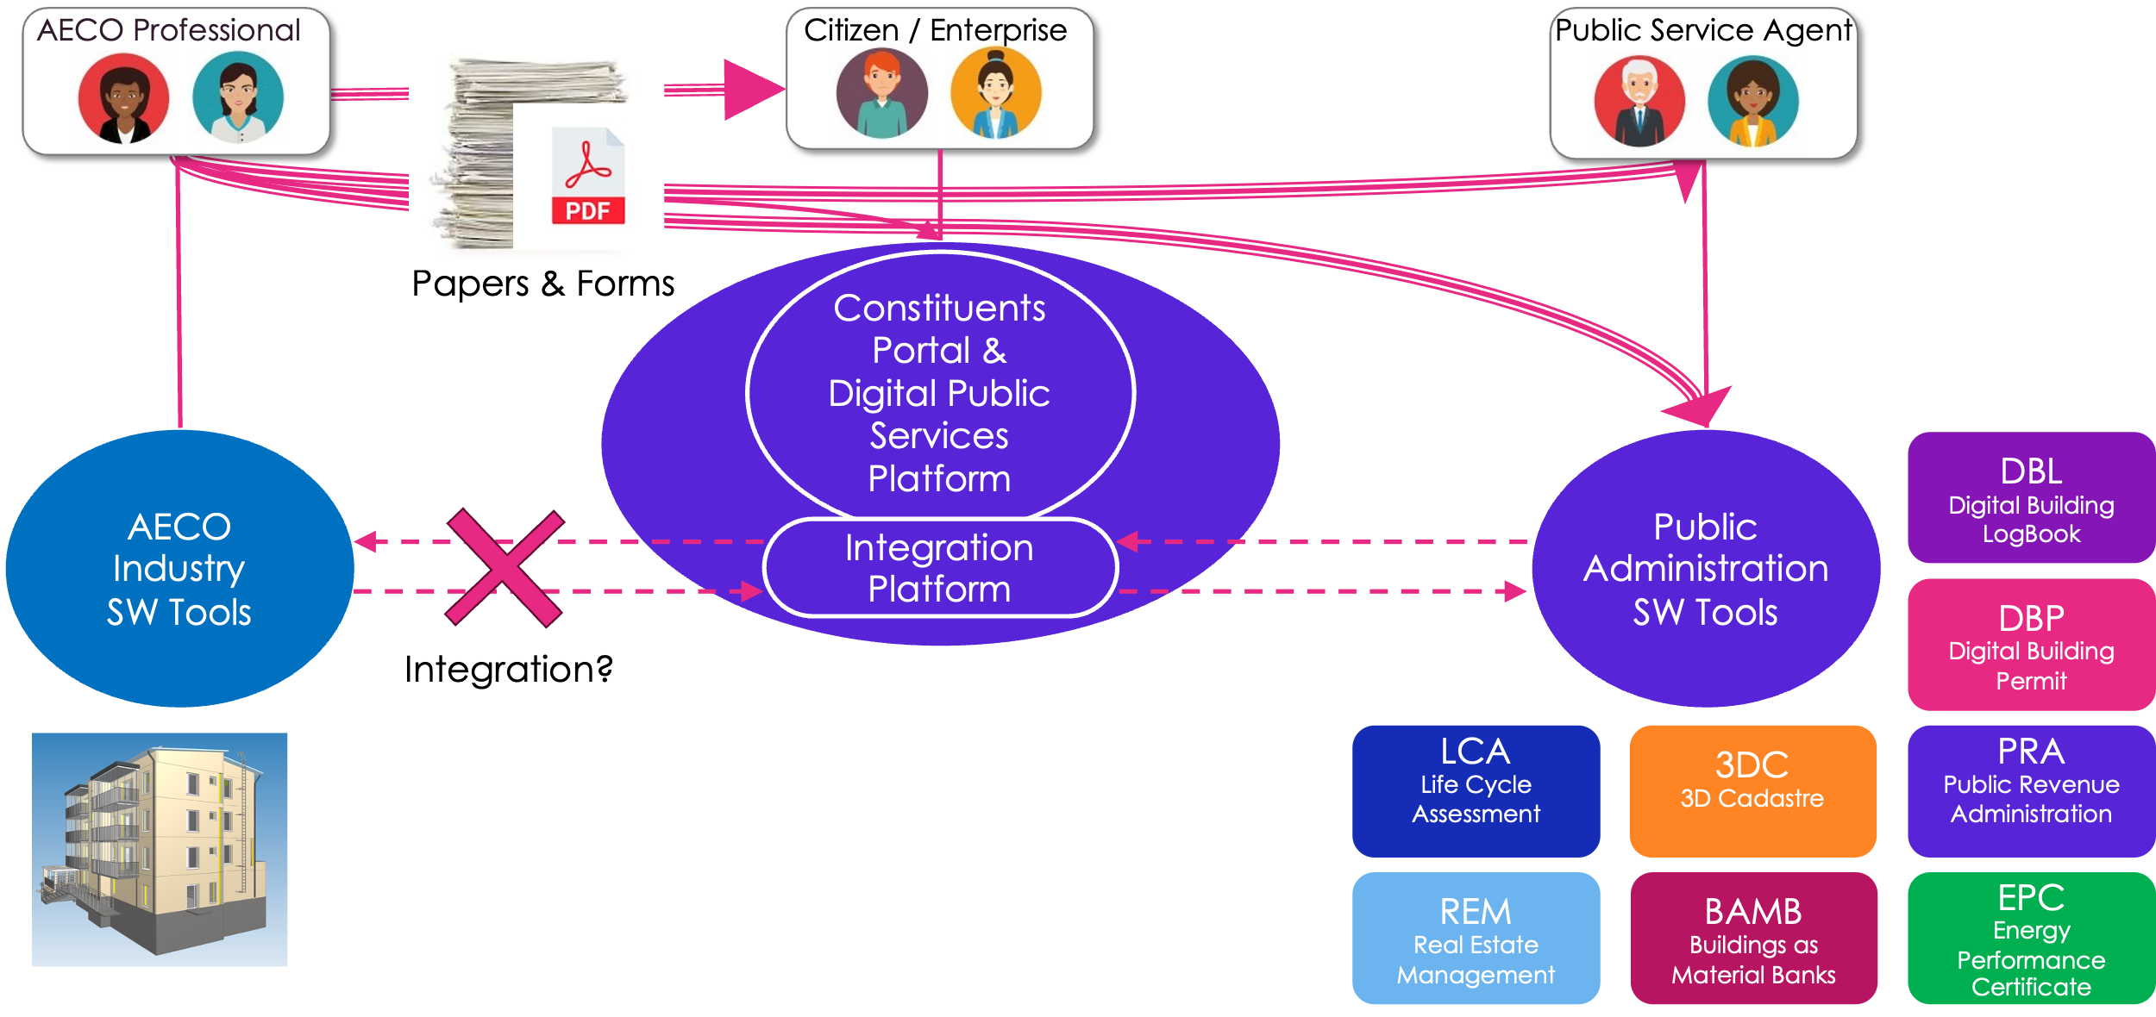

Slide 13
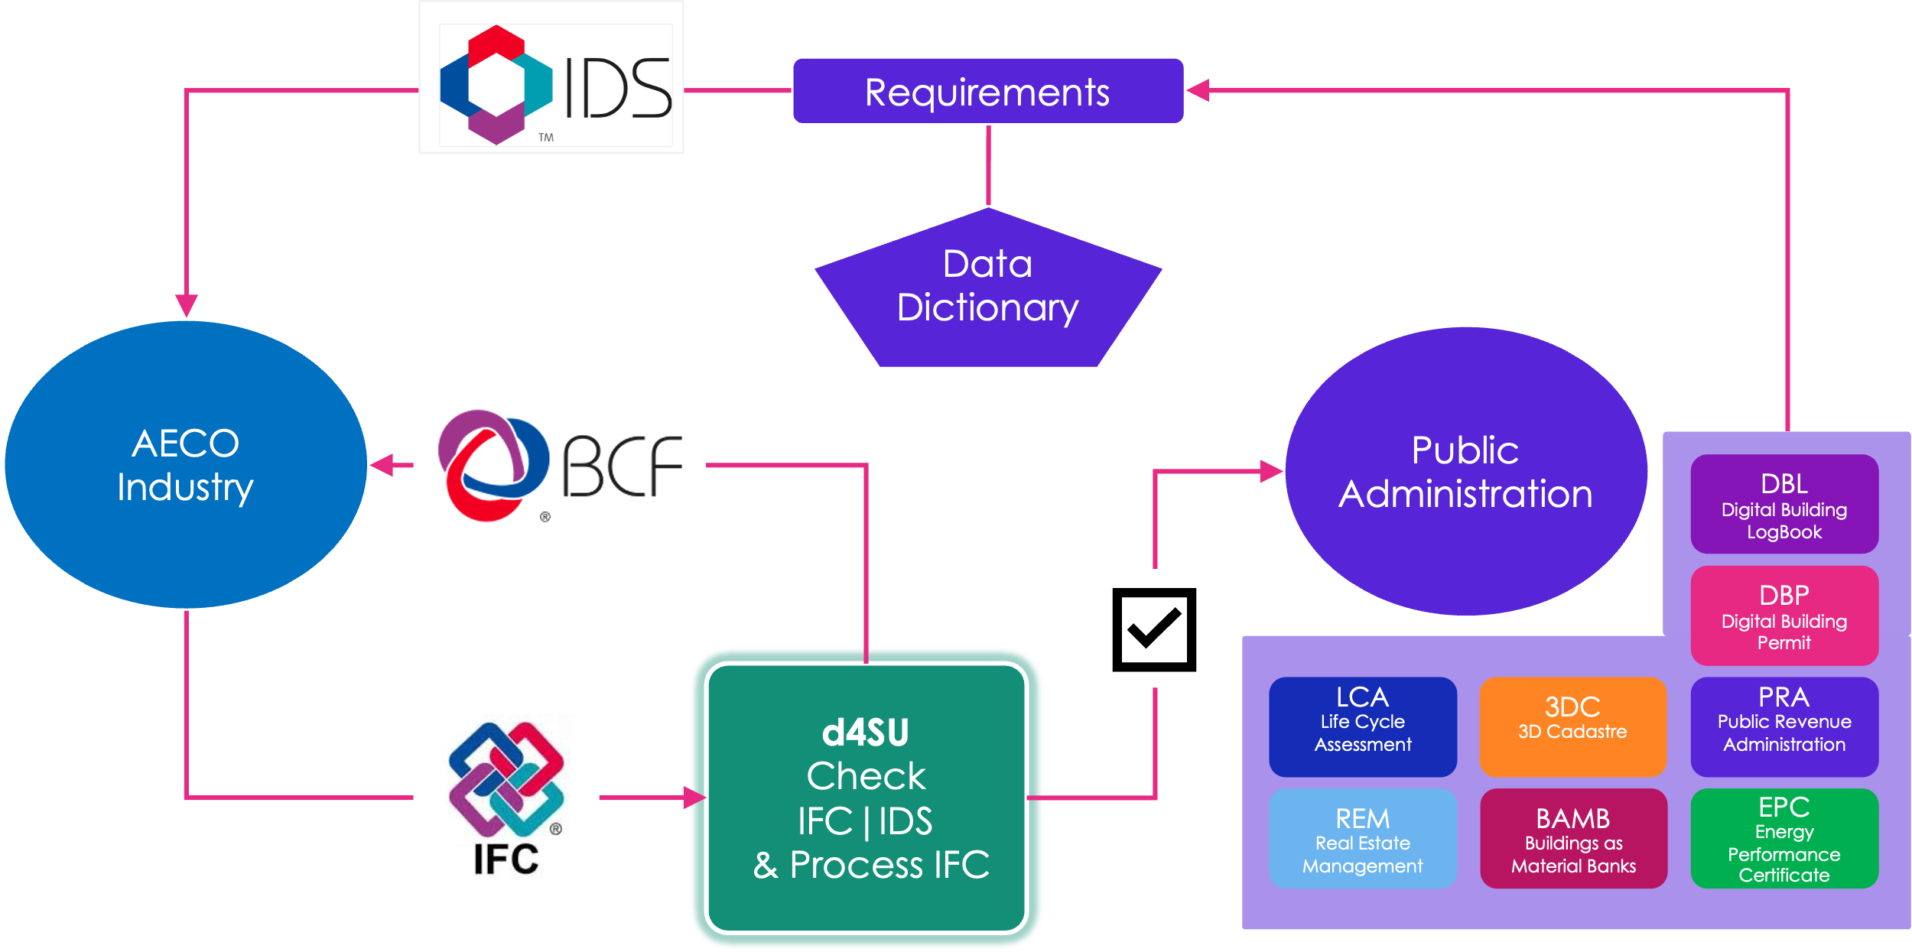

Slide 14
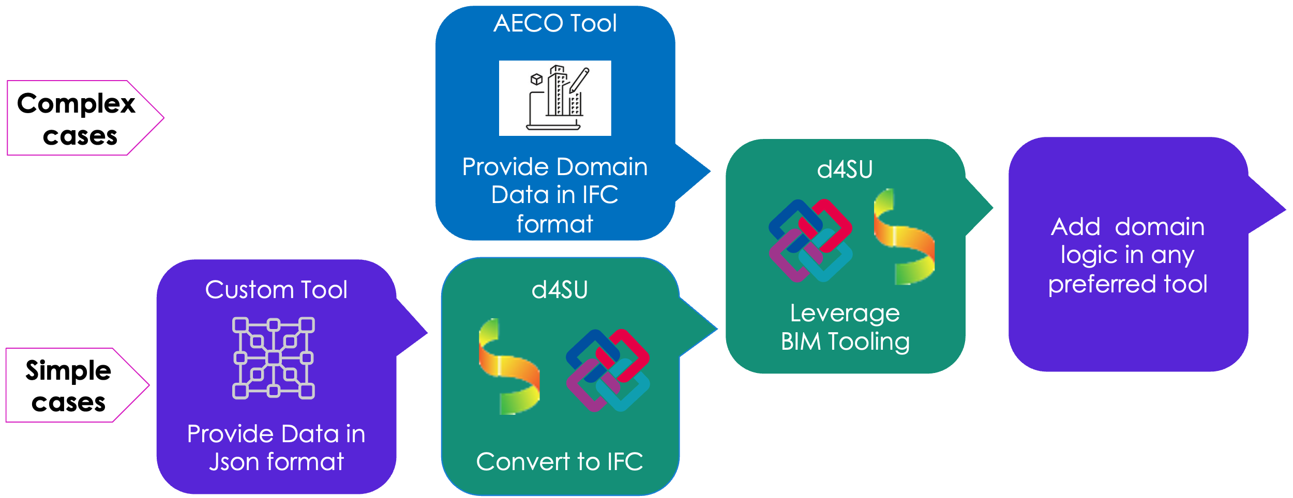

Slide 15
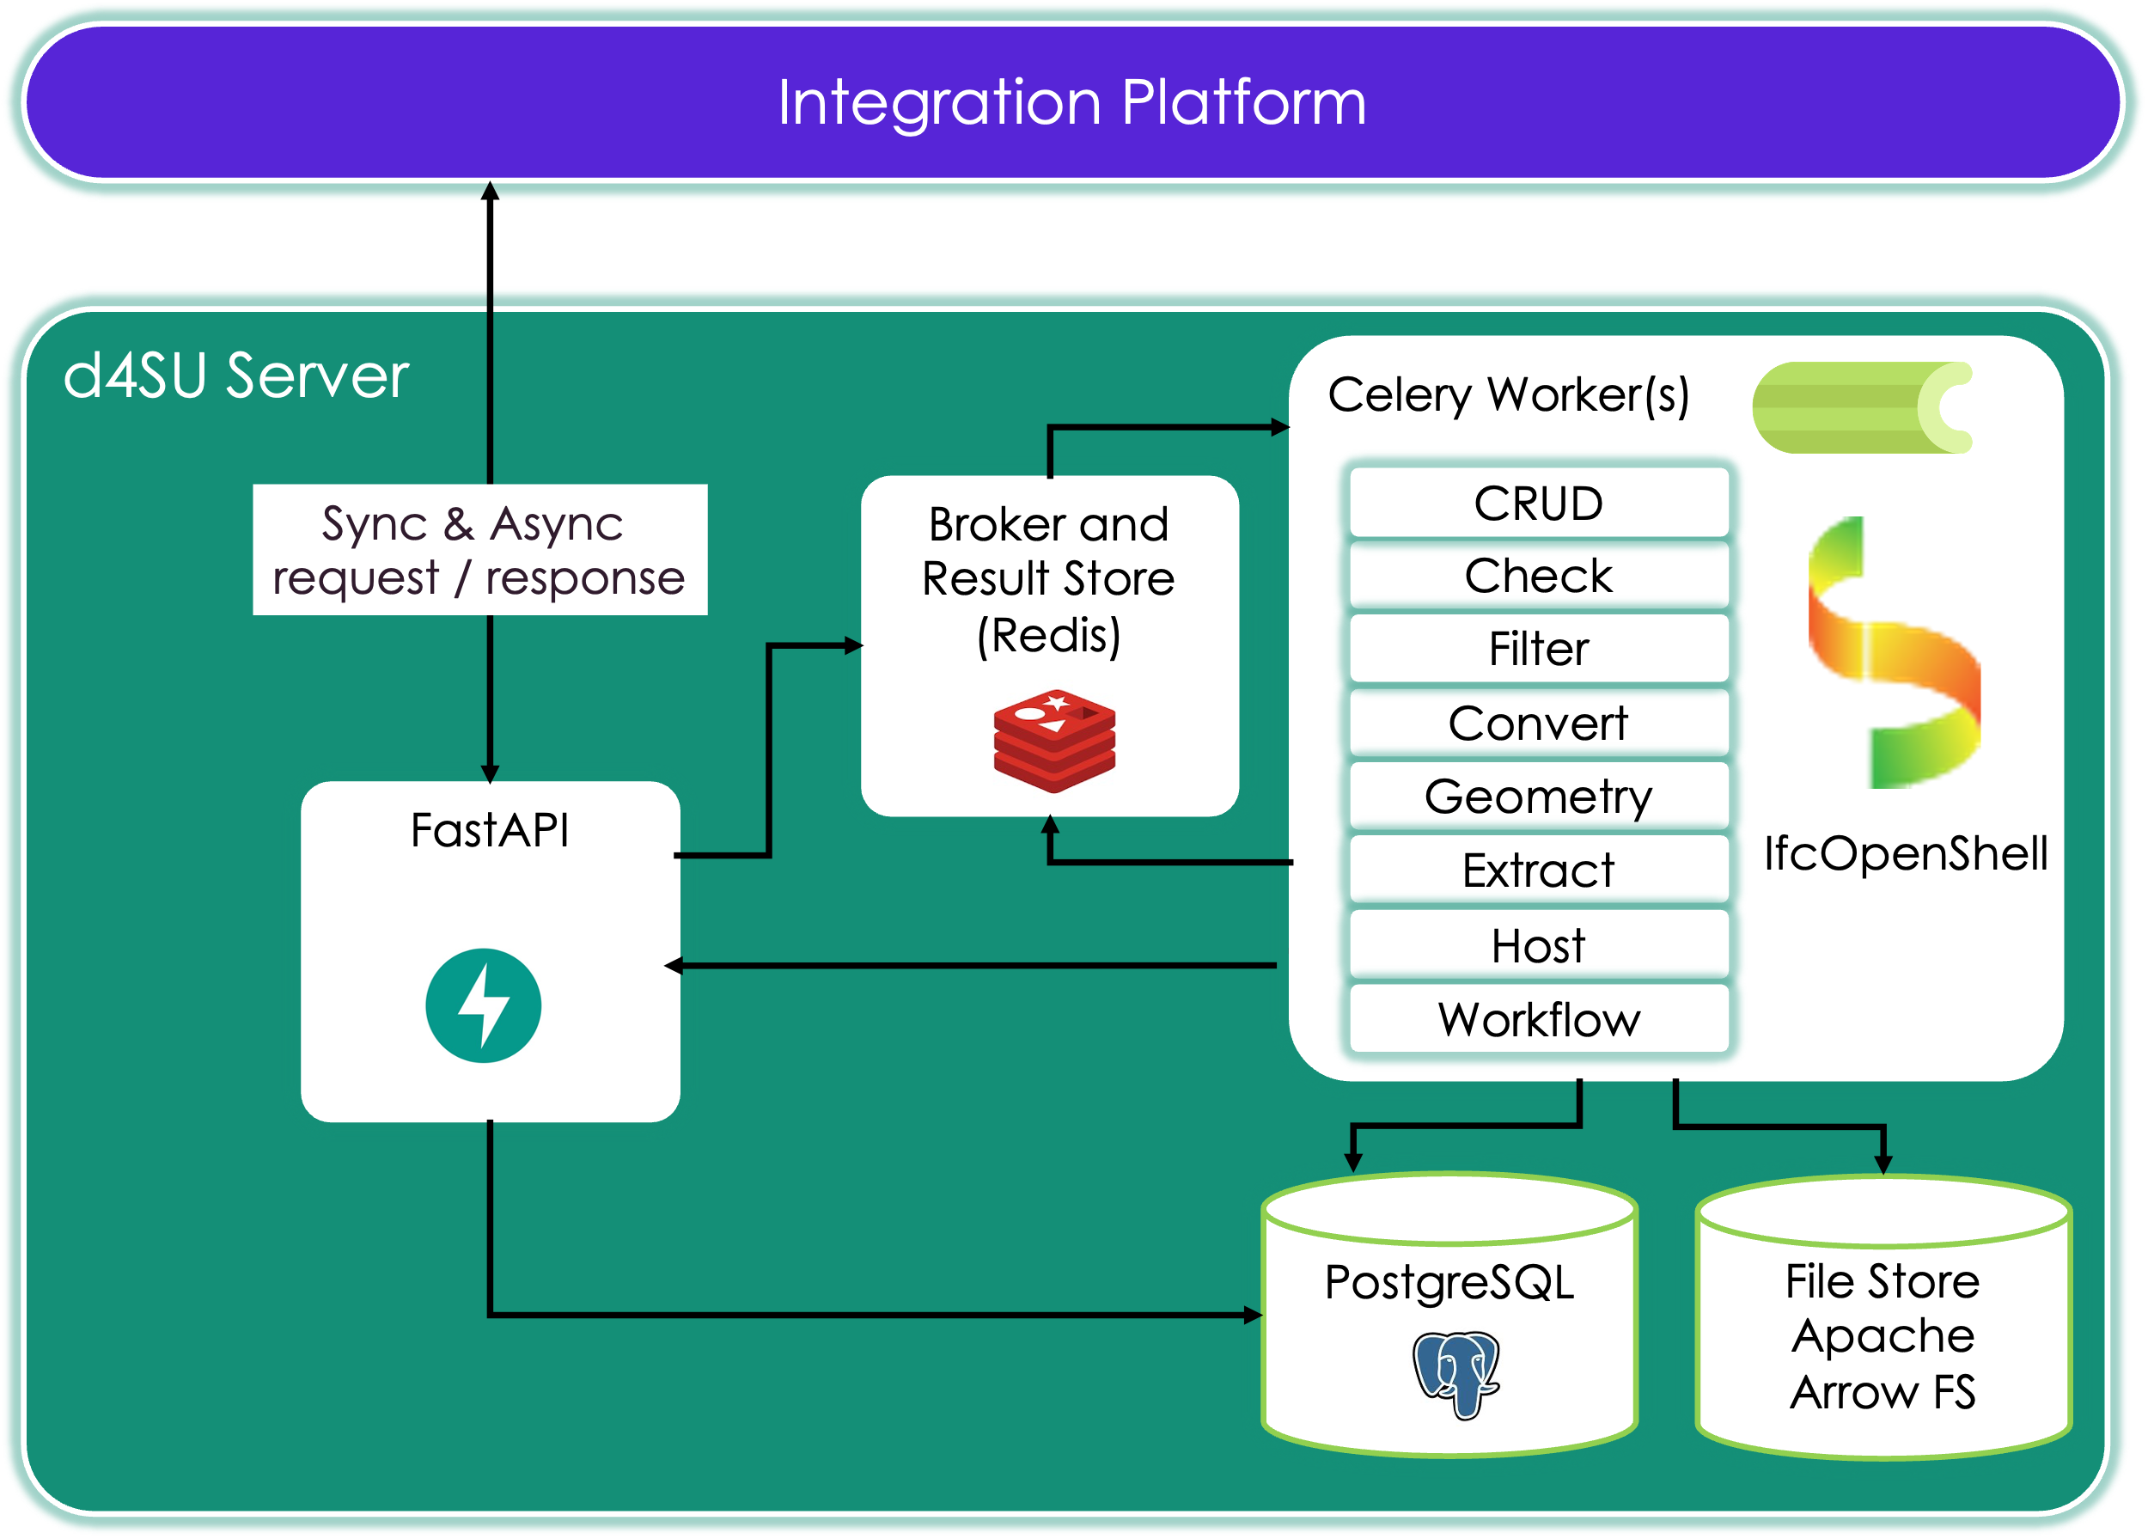

Slide 16
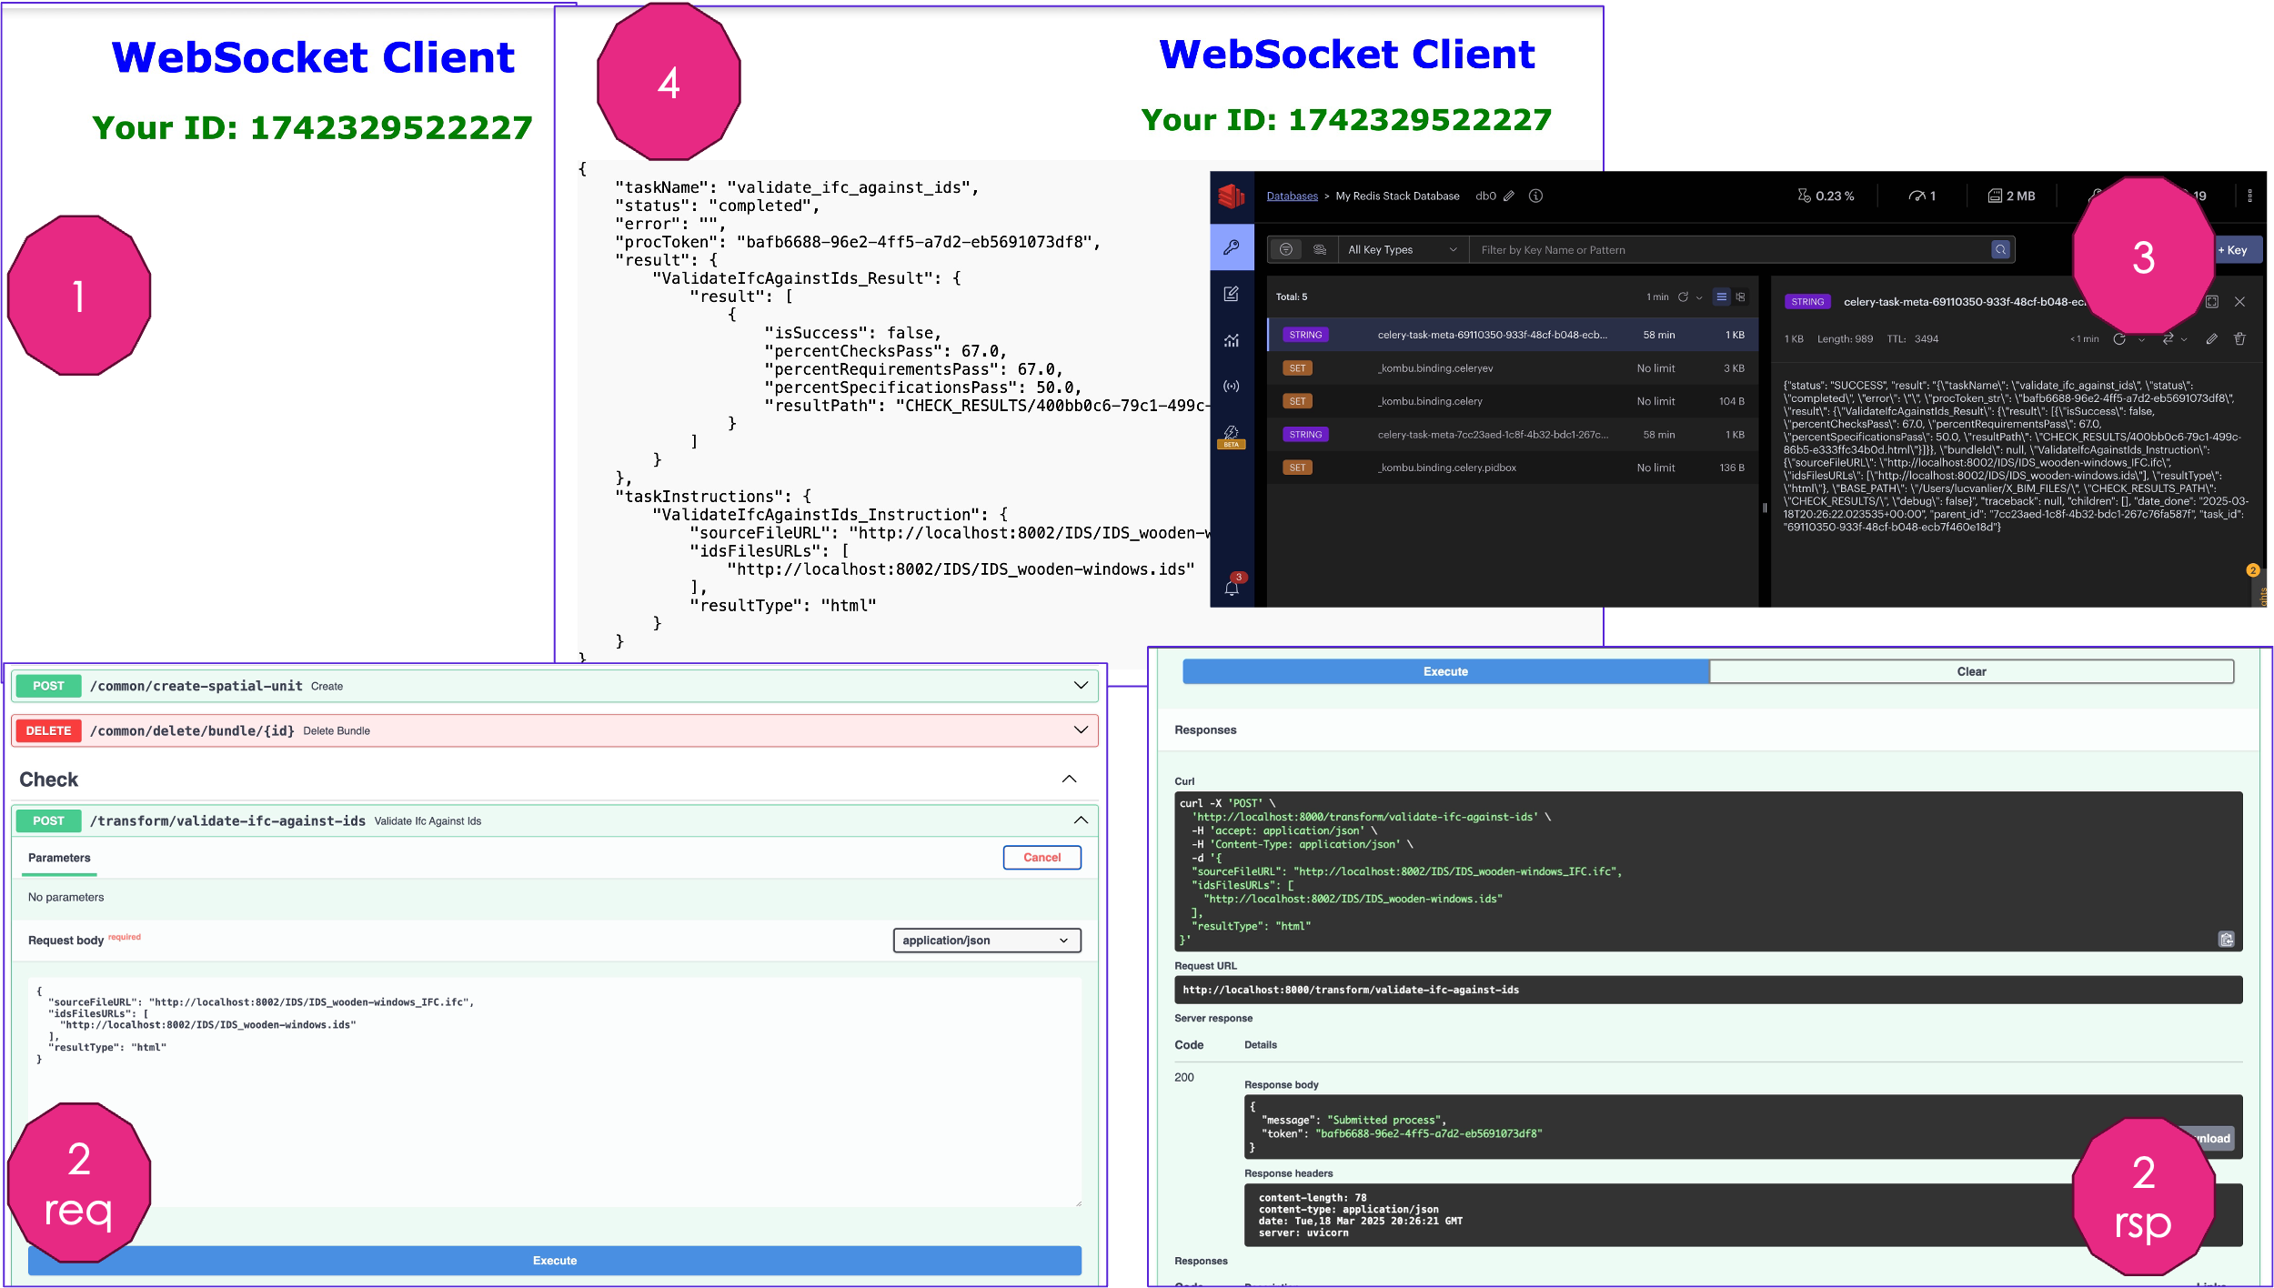

Slide 18
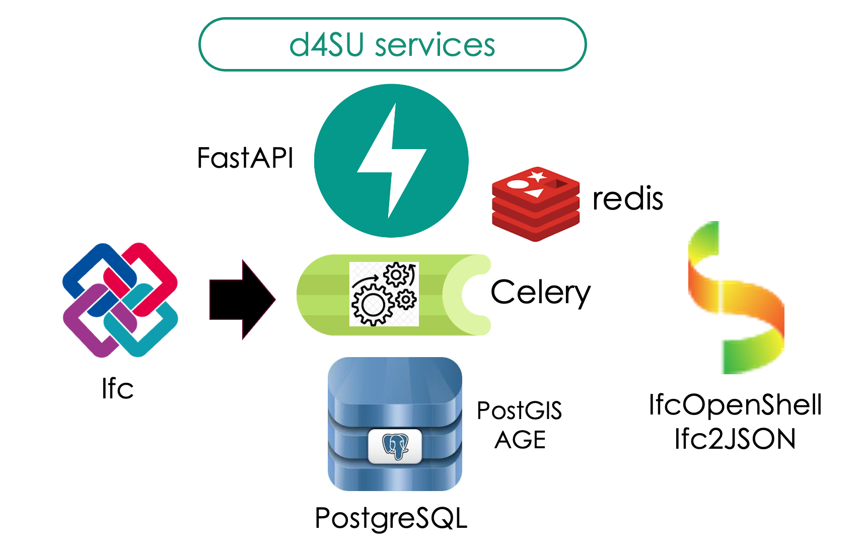


Slide 19
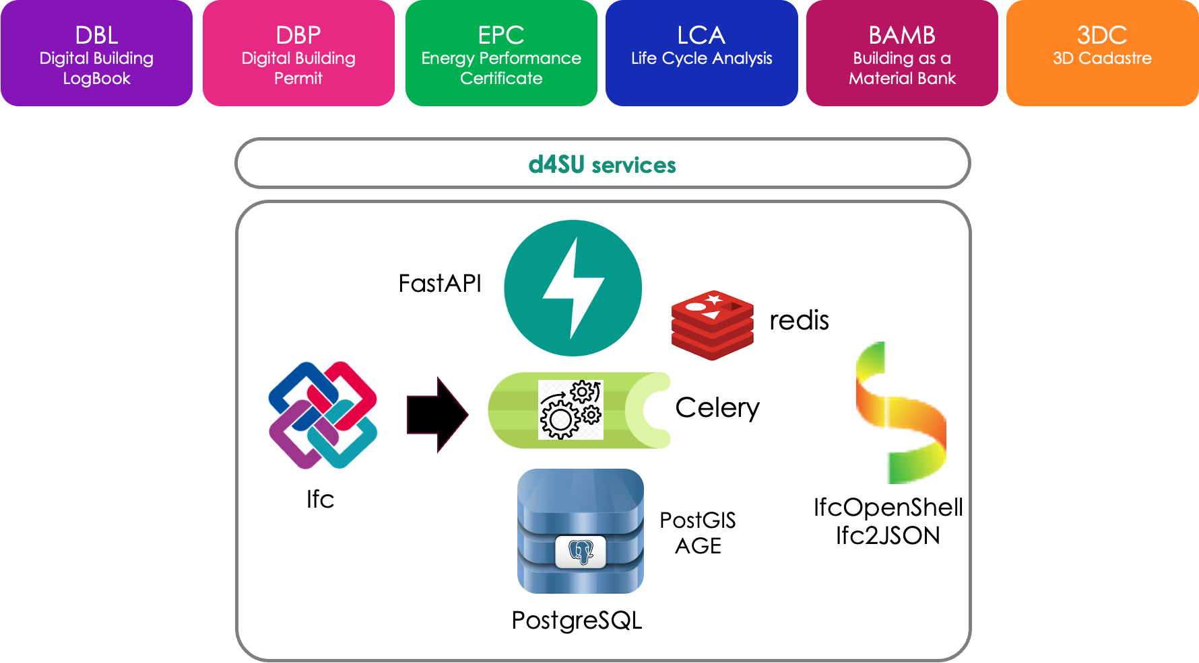

Slide 20
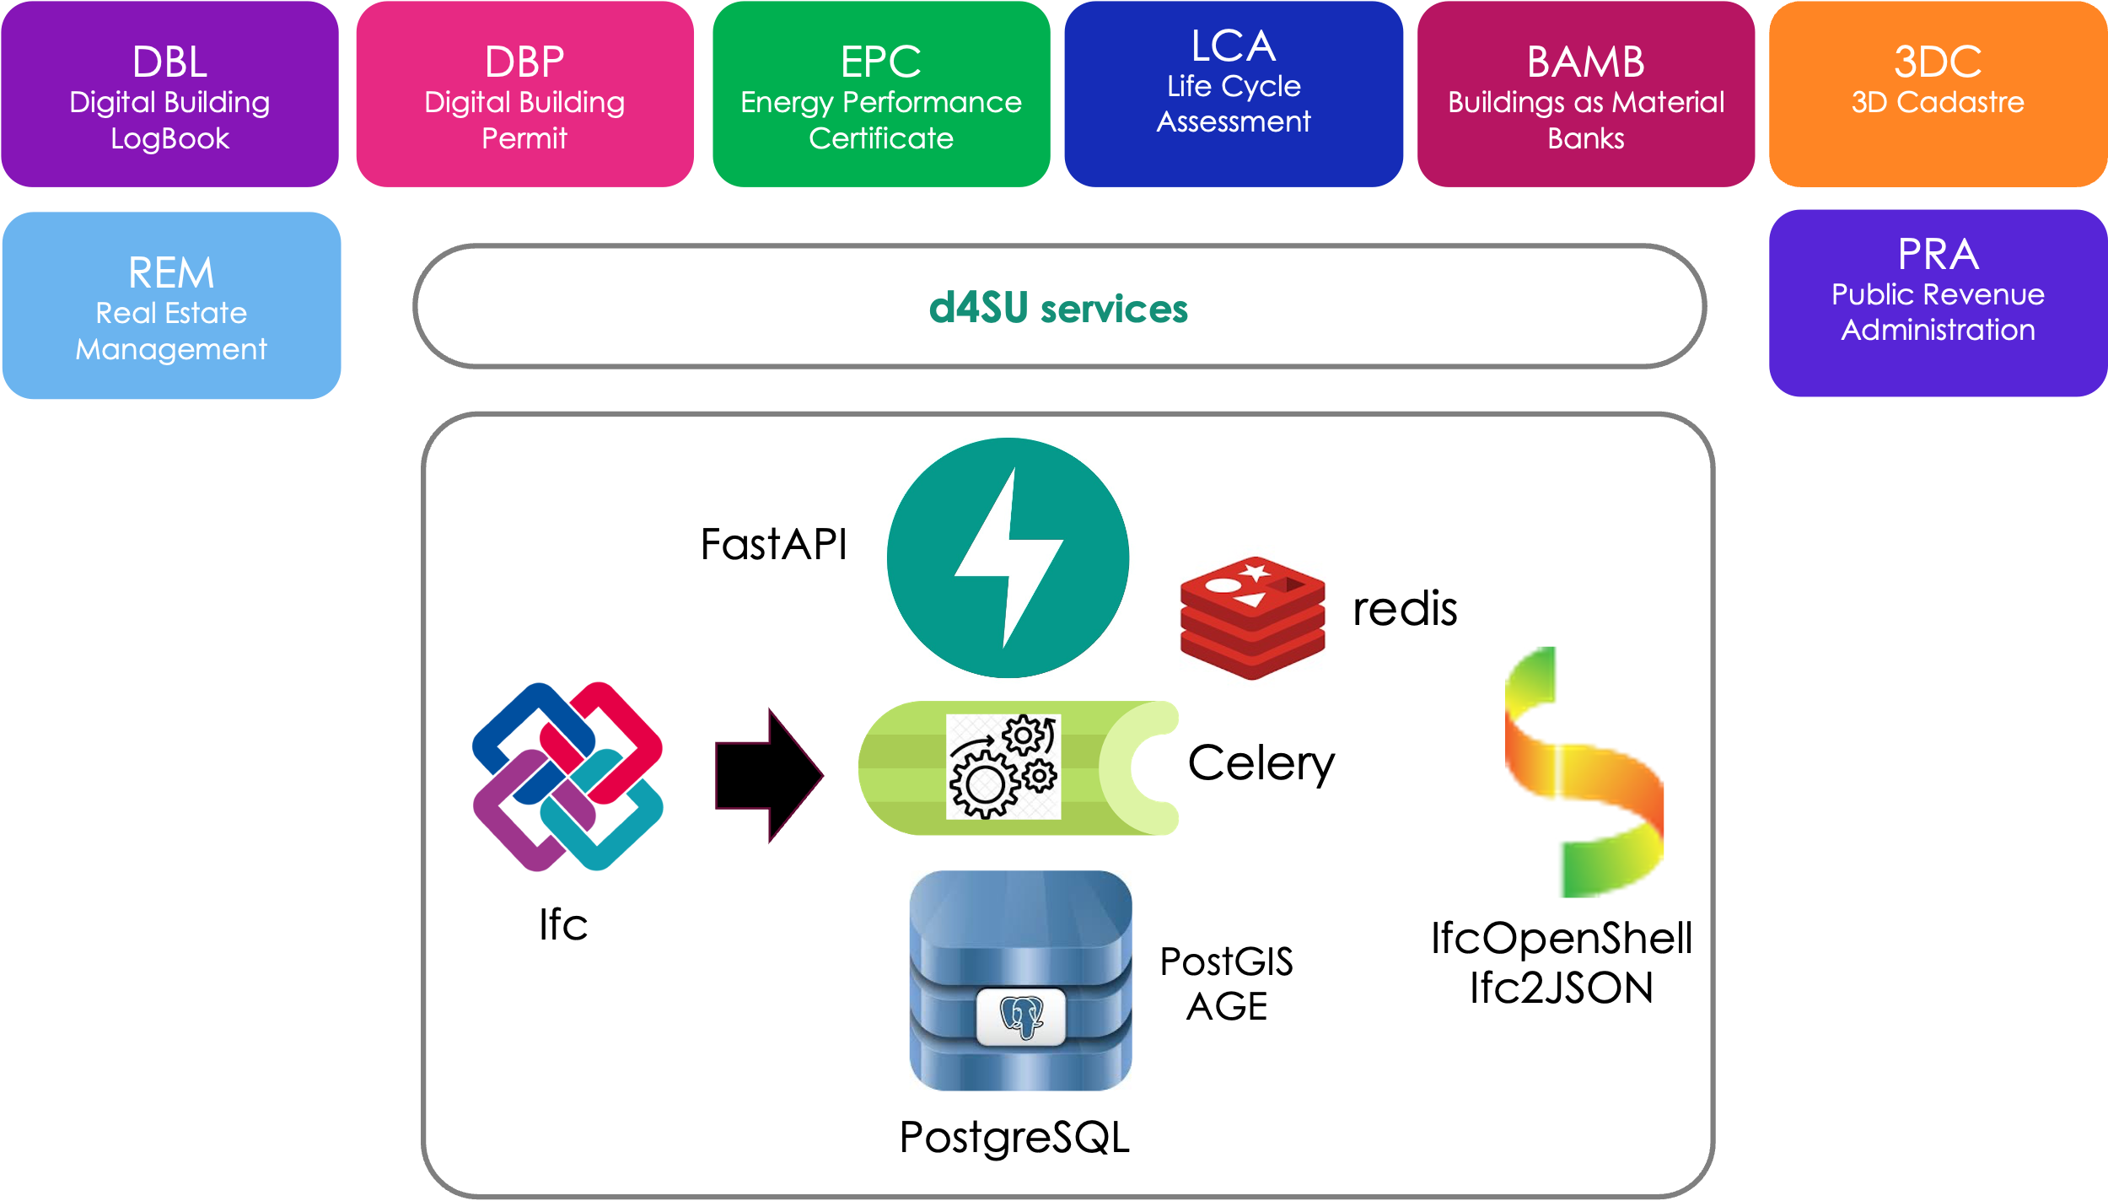

Slide 21


Slide 22
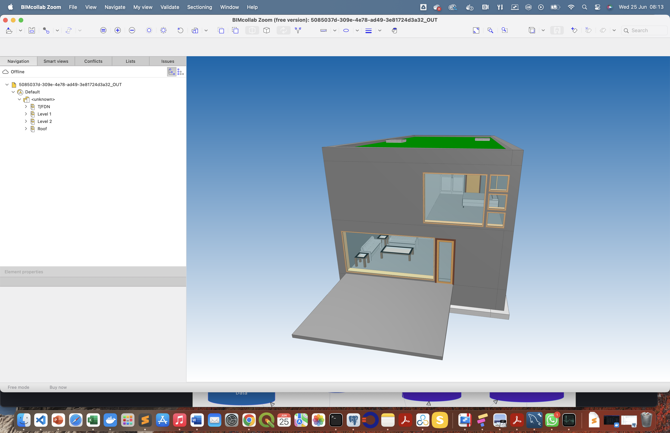

Slide 23
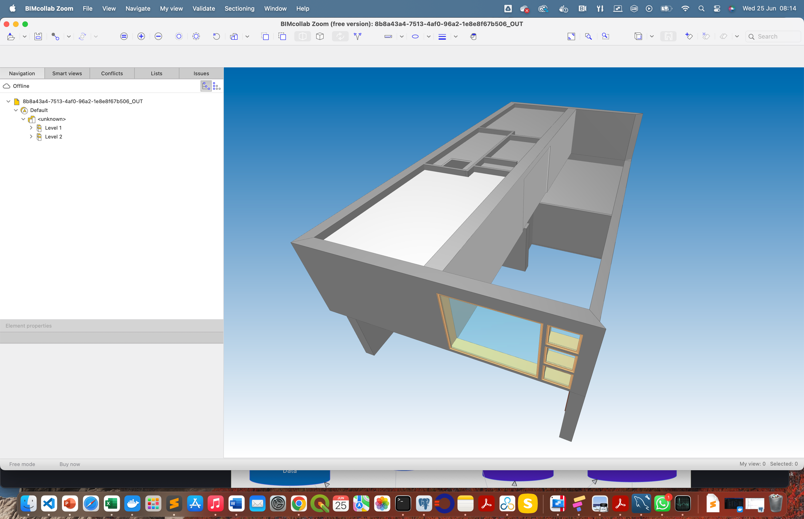
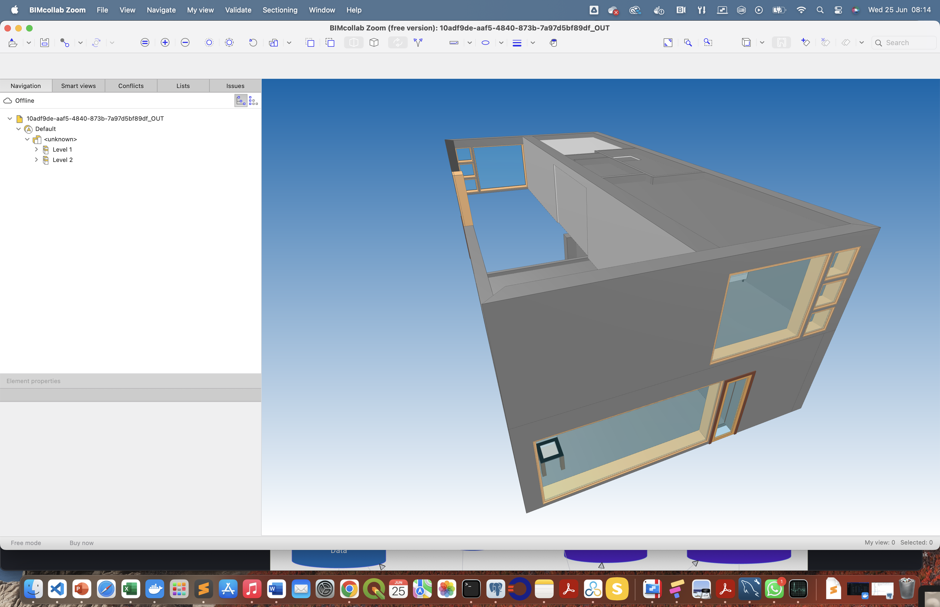

Slide 25
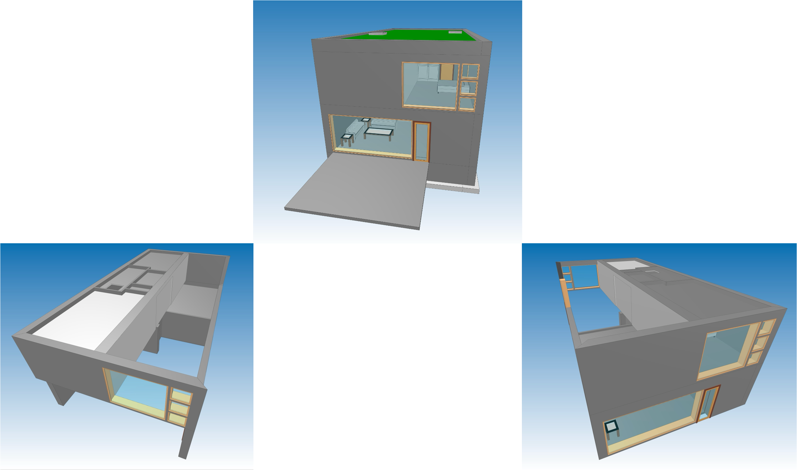

Slide 27


